Slide 1
Single-Source Shortest Path
SUBMITTED BY :- dimpal kataniya
ROLL NO. – 181210022
CSE 2ND YEAR

Slide 2
Single-Source Shortest Path
Single Destination Shortest Path Problem : Find a shortest path from the given destination vertex t to the vertex v. By reversing the direction of each edge in the graph we can reduce each problem to single-source problem.
Single Pair Shortest Path Problem : Find a shortest path from u to v for given vertices u and v. If we solve the single-source problem with source vertex u, we solve this problem also.

Slide 3
DIJKSTRA’S ALGORITHM :-
Dijkstra’s algorithm solves the single-source shortest-paths problem on a weighted, directed graph G = (V,E) for the case in which all edge weights are nonnegative.
Dijkstra’s algorithm maintains a set S of vertices whose ﬁnal shortest-path weights from the source s have already been determined.
The algorithm repeatedly selects the vertex u є V - S with the minimum shortest-path estimate, adds u to S, and relaxes all edges leaving u.
In the following implementation, we use a min-priority queue Q of vertices, keyed by their d values.

Slide 4
Algorithm :-
DIJKSTRA(G,w,s)
INITIALIZE-SINGLE-SOURCE(G,s)
S = 
Q = G.V
while Q != 
u = EXTRACT-MIN(Q)
S = S U {u}
for each vertex v є G.Adj[u]
RELAX(u,v,w)

Slide 5
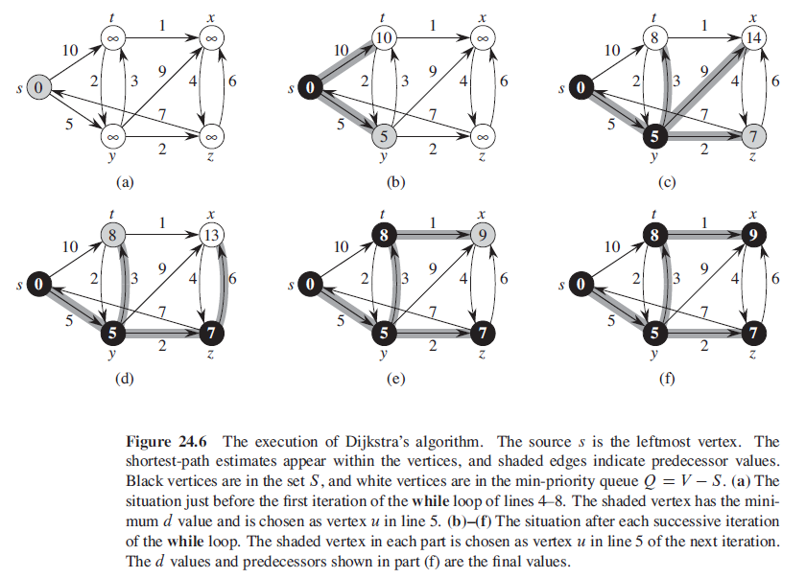
Example problem :-

Slide 6
Time complexity :-
Dijkstra's algorithm visits every node once (=O(V)),and tries to relax all adjacent nodes via the edges.
Therefore it iterates over each edge exactly twice (=O(E)), each time accessing the priority queue up to two times in O(logV).
Therefore the complexity is O(ElogV+V).

Slide 7
BELLMAN FORD ALGORITHM :-
The Bellman-Ford algorithm solves the single-source shortest-paths problem in the general case in which edge weights may be negative.
Like other Dynamic Programming Problems, the algorithm calculates shortest paths in a bottom-up manner.
It first calculates the shortest distances which have at-most one edge in the path.
Then, it calculates the shortest paths with at-most 2 edges, and so on.
After the i-th iteration of the outer loop, the shortest paths with at most i edges are calculated.
There can be maximum |V| – 1 edges in any simple path, that is why the outer loop runs |v| – 1 times.
The idea is, assuming that there is no negative weight cycle, if we have calculated shortest paths with at most i edges, then an iteration over all edges guarantees to give shortest path with at-most (i+1) edges

Slide 8
Algorithm :-
BELLMAN-FORD(G,w,s)
INITIALIZE-SINGLE-SOURCE(G,s)
for i = 1 to |G.V|-1
for each edge (u,v) є G.E
RELAX(u,v,w)
for each edge (u,v) є G.E
if v.d > u.d + w(u,v)
return FALSE
return TRUE

Slide 9
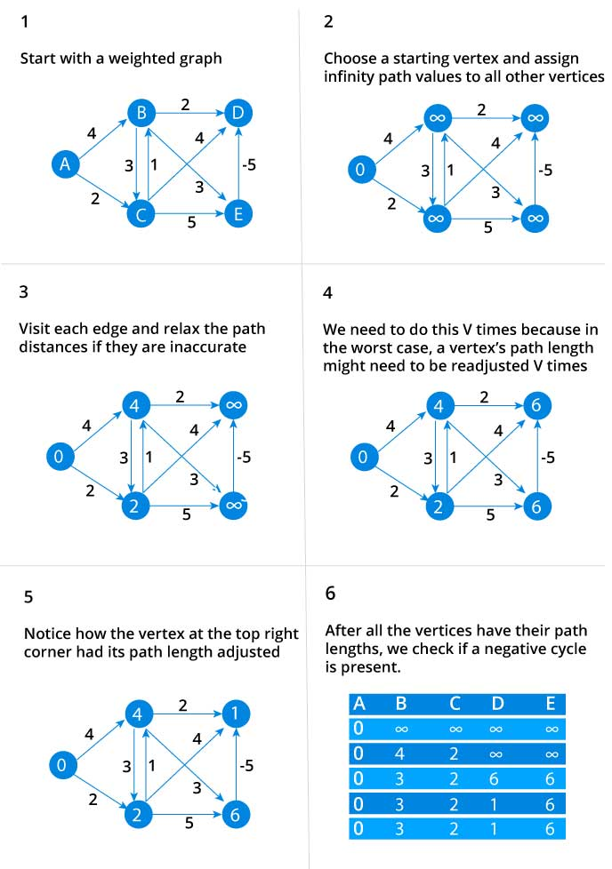
Example problem :-

Slide 10
Time complexity :-
The Bellman-Ford algorithm runs in time O(VE).
Since the initialization in line 1 takes O(V) time.
Each of the |V| -1 passes over the edges in lines 2–4 takes O(E) time,
And the for loop of lines 5–7 takes O(E) time.

